Slide 1

Chapter 18
Virtual-Circuit Networks:
Frame Relay and ATM

Slide 2
18-1 FRAME RELAY
Frame Relay is a virtual-circuit wide-area network that was designed in response to demands for a new type of WAN in the late 1980s and early 1990s.
Topics discussed in this section:
Architecture
Frame Relay Layers
Extended Address
FRADs
VOFR
LMI

Slide 3
Frame Relay
Frame Relay
  Prior to FR, they were using a virtual-circuit switching network called X.25.
  Drawbacks of X.25
    X.25 has a low 64 kbps data rate.
    X.25 has extensive flow and error control at the data & the network layer
    - Flow & error control at both layers create a large overhead and slow down transmissions.
    X.25 has its own network layer that user’s data are encapsulated in the network layer packets of X.25.
    - Internet has its own network layer.
    - If the Internet wants to use X.25, this doubles the overhead.

Slide 4
X.25 vs. Frame Relay
Feature
X.25
Frame Relay
Connection establishment
At the network layer
None
Hop-by-hop flow control
and error control
At the data link layer
None
End-to-end flow control
and error control
At the network layer
None
Data rate
Fixed
Bursty
Multiplxing
At the network layer
At the data link layer
Congestion control
Not necessary
Necessary

Slide 5
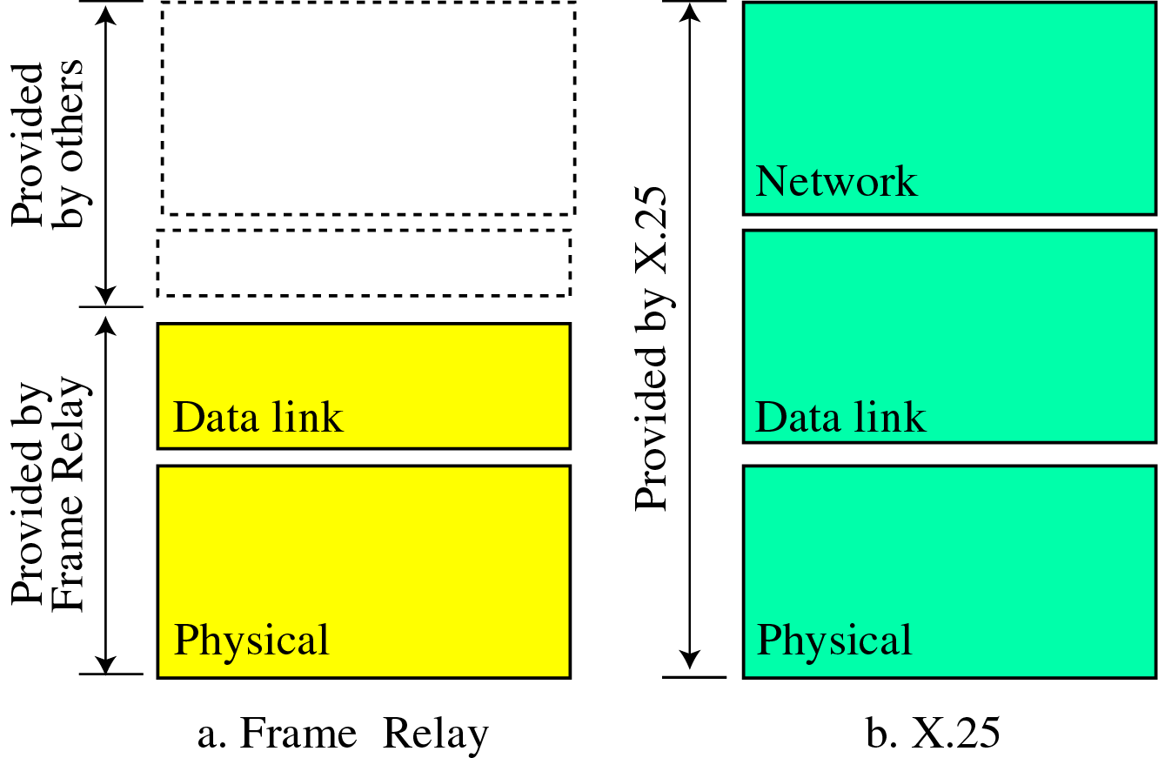
X.25 vs. Frame Relay

Slide 6
Features of Frame Relay
Operating in higher speed such as 1.544 Mbps, 45Mbps
Operating in just the physical and data link layers
Allowing bursty data
Allowing a frame size of 9000 bytes, which can accommodate all local area network fame sizes
less expensive
Error detection at the data link layer only
  no flow control or error control

Slide 7
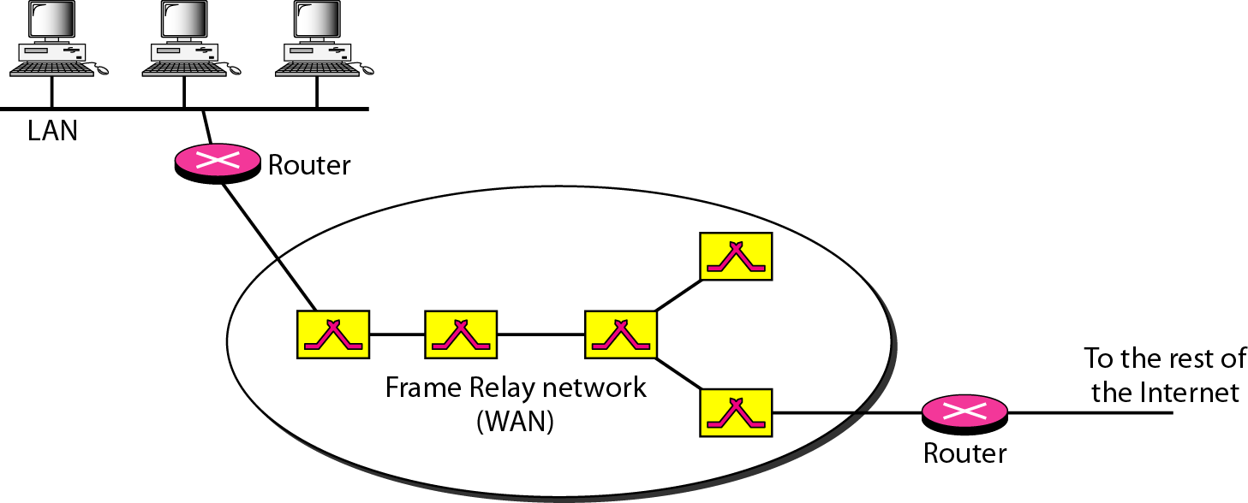
Architecture (Frame Relay)
Figure 18.1 Frame Relay network

Slide 8
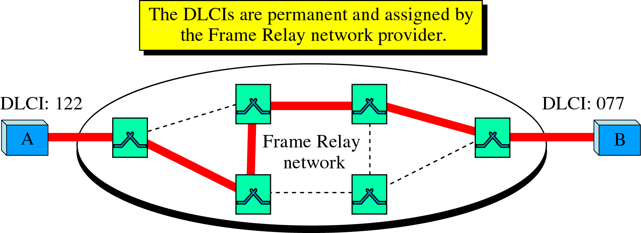
Virtual Circuit (Frame Relay)
A Virtual Circuit Identifier (VCI) in FR is identified by a number called a Data Link Connection Identifier (DLCI)
Permanent Virtual Circuits (PVC)
  The connection setup is simple. The corresponding table entry is recorded for all switches by the administrator.

Slide 9
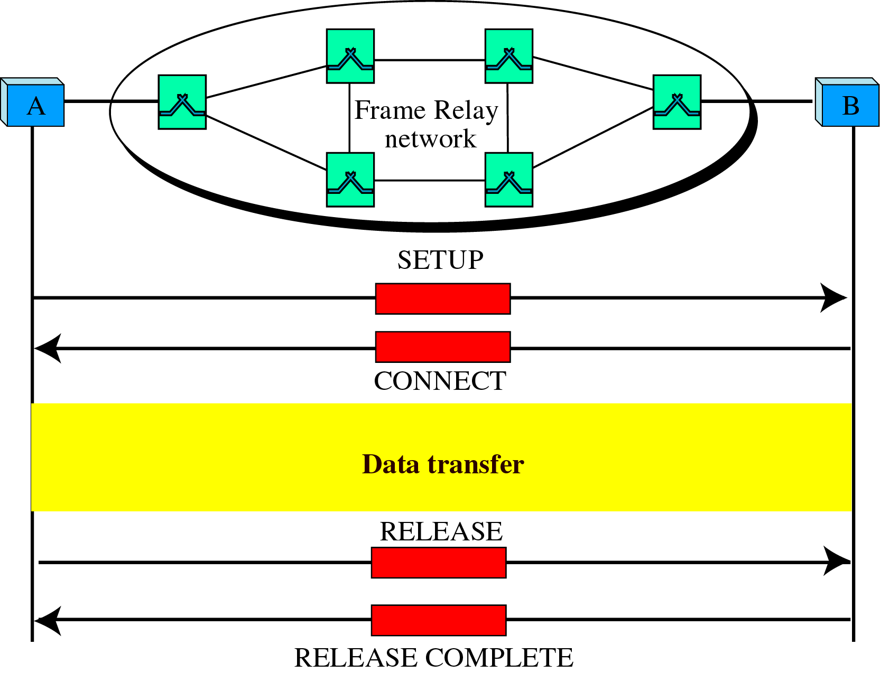
Virtual Circuit (Frame Relay)
Switched Virtual Circuit (SVC)
  The SVC creates a temporary, short connection that exists only when data are being transferred between source and destination.

Slide 10
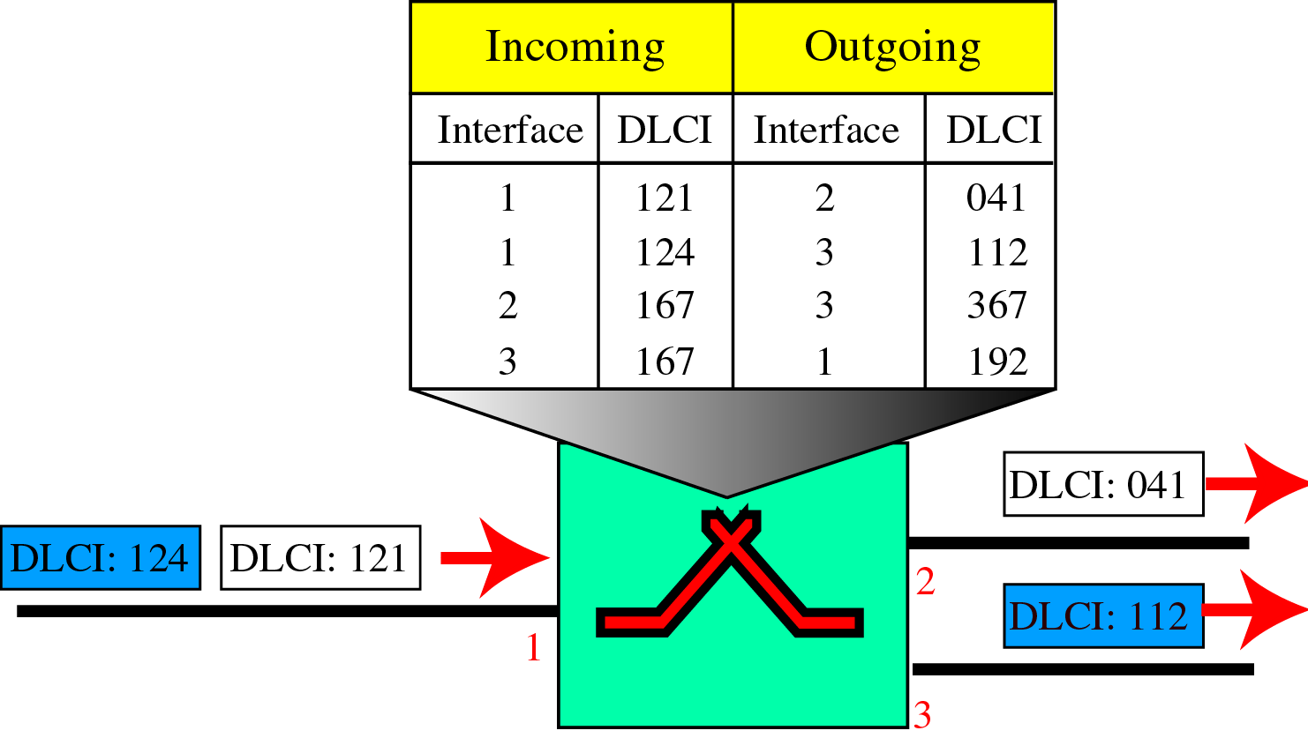
FR Switch
Switches
  Each switch in a Frame Relay network has a table to route frames.

Slide 11
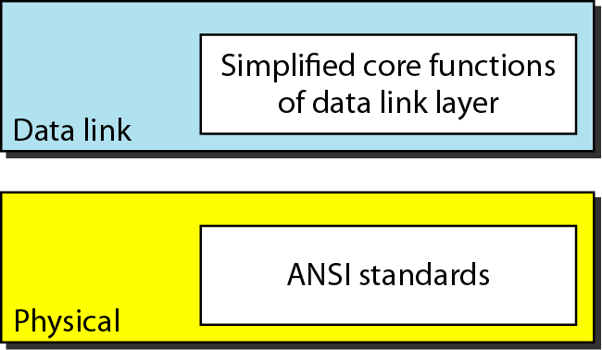
Frame Relay Layers
Frame Relay operates only at the physical and data link layers
Frame Relay does not provide flow or error control; they must be provided
by the upper-layer protocols.

Slide 12
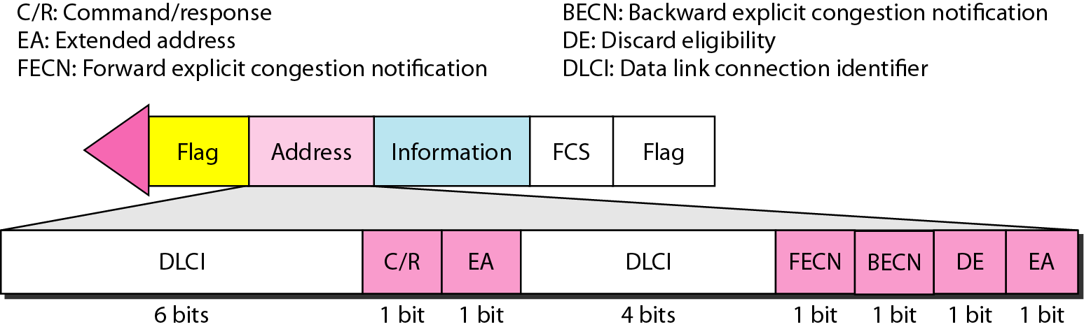
Frame Relay frame
Figure 18.3 Frame Relay frame
EA 0 : meaning that another address byte is to follow
DE 1 : to discard this frame if there is congestion

Slide 13
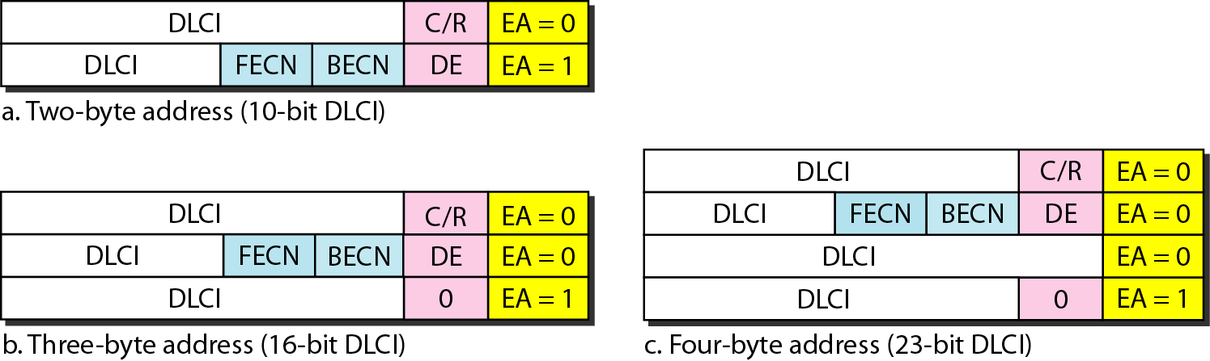
Frame Relay frame
(EXTENDED ADDRESS)
Figure 18.4 Three address formats

Slide 14
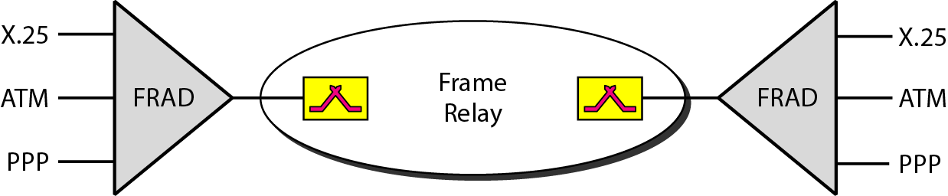
FRAD
FRAD (Frame Relay Assembler/ Disassembler)
  A FRAD assembles and disassembles frames coming from other protocols to allow them to be carried by Frame Relay frames.
Figure 18.5 FRAD

Slide 15
Voice Over Frame Relay
VOFR (Voice Over Frame Relay)
  VOFR sends voice through the network.
  Voice is digitized using PCM and then compressed.
  The result is sent as data frames over the network.
LMI (Local Management Information)
  F/R was originally designed to provide PVC connections.
    There was not a provision for controlling or managing intefaces.
  LMI is a protocol added recently to the FR protocol to provide more management features.
    A keep alive mechanism to check if data are flowing.
    Multicasting mechanism
    A mechanism to allow an end system to check the status of a switch.

Slide 16
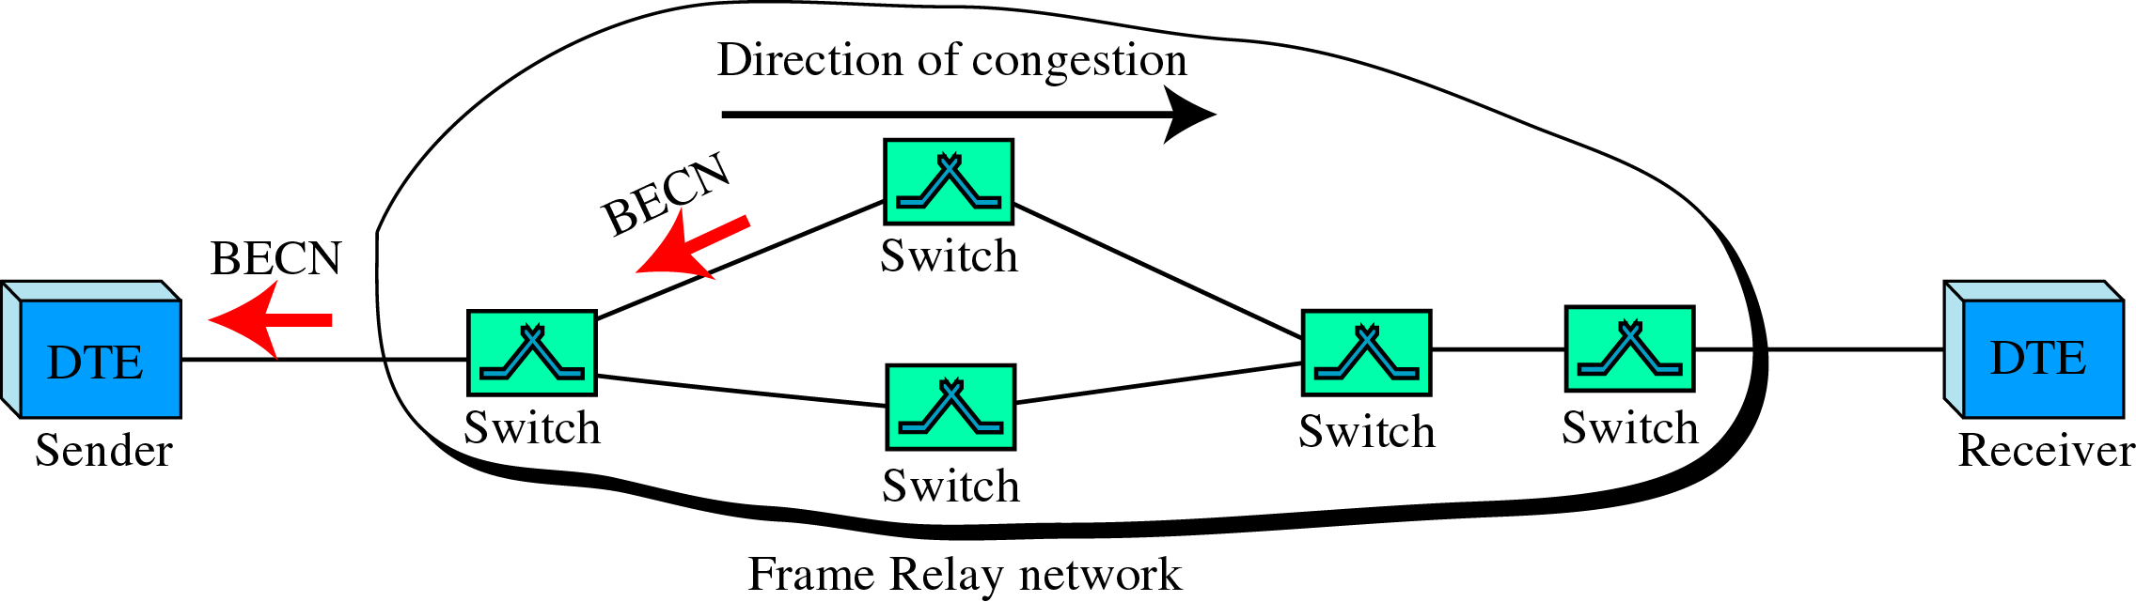
Congestion Control (Frame Relay)
Congestion Avoidance
  The FR protocol uses 2 bits in the frame to explicitly warn the source and the destination of the presence of congestion.
BECN(Backward Explicit Congestion Notification)
  BECN bit warns the sender of congestion in the network.

Slide 17
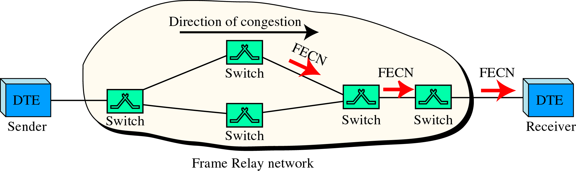
Congestion Control (Frame Relay)
FECN(Forward Explicit Congestion Notification)
  FECN bit is used to warn the receiver of congestion in the network.

Slide 18
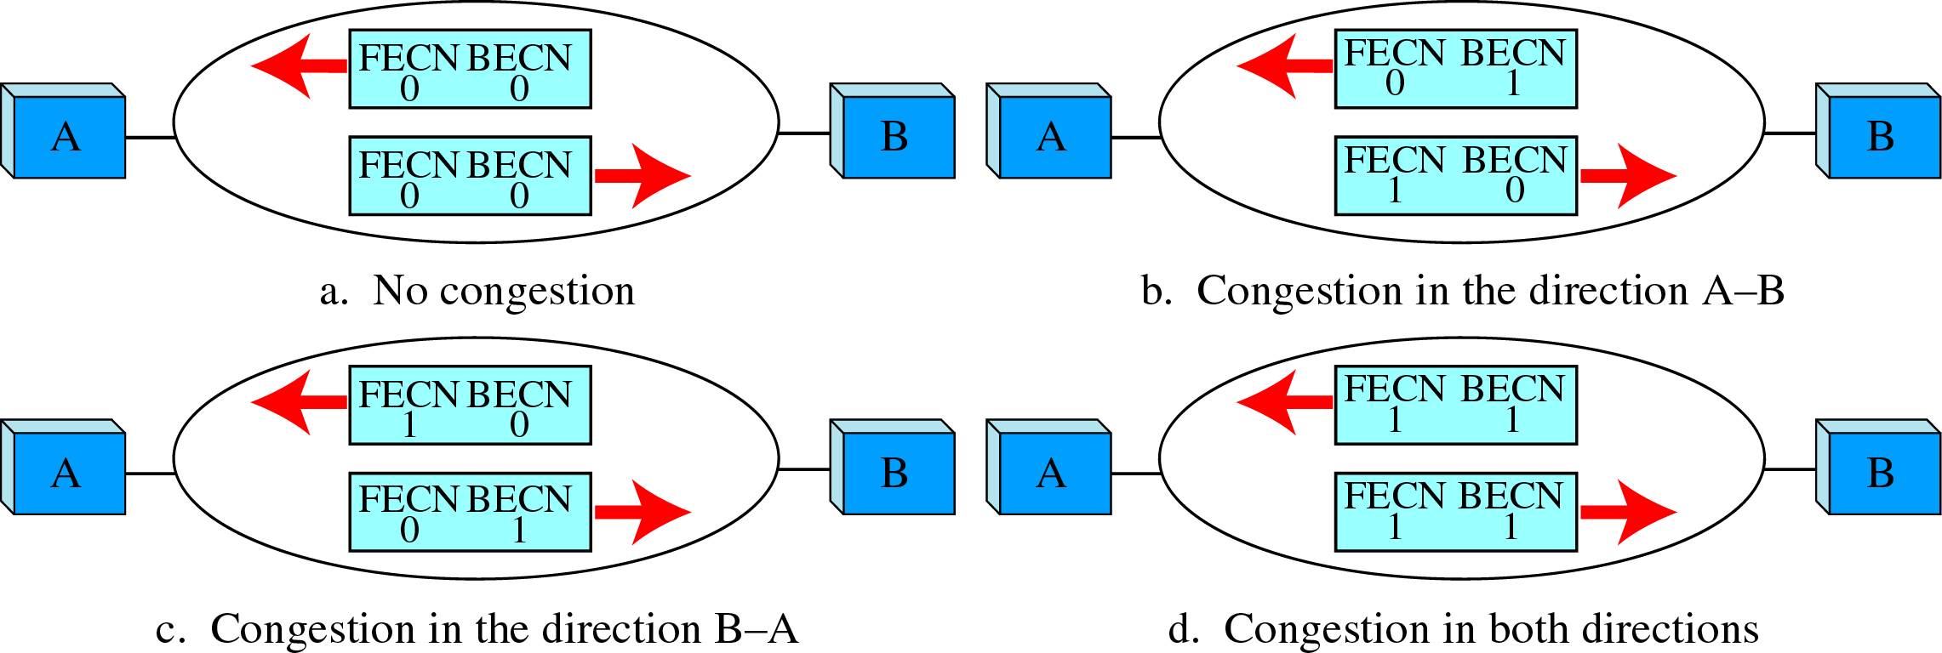
Congestion Control (Frame Relay)
4 cases of congestion

Slide 19
18-2 ATM
Asynchronous Transfer Mode (ATM) is the cell relay protocol designed by the ATM Forum and adopted by the ITU-T.
Topics discussed in this section:
Design Goals
Problems
Architecture
Switching
ATM Layers

Slide 20
ATM - Design Requirements
  Foremost is the need for a transmission system to optimize the use of high-data-rate transmission media, in particular optical fiber.
    A technology is needed to take advantage of large bandwidth and strength to noise degradation.
  The system must interface with existing systems.
  Must be implemented inexpensively.
  The new system must be able to work with and support the existing telecommunications hierarchies.
  The new system must be connection-oriented to endure accurate and predictable delivery.
  One objective is to move as many of the function to hardware as possible and eliminate as many software functions as possible.

Slide 21
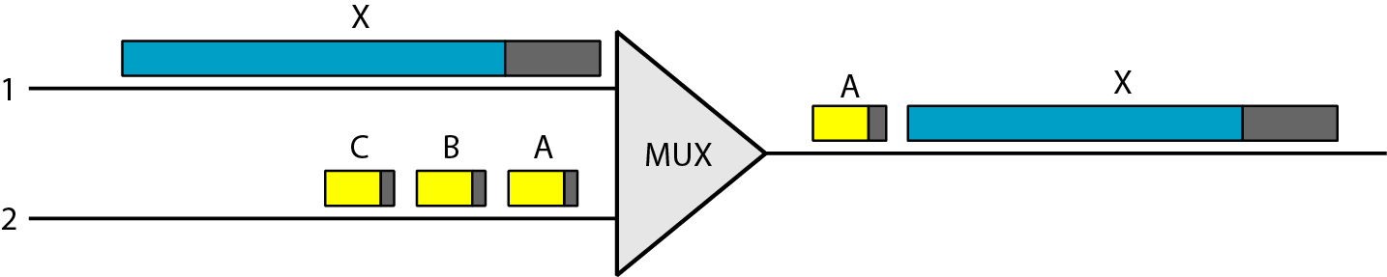
Problems (ATM)
Problems associated with existing systems.
  Frame networks
    Different protocols use frames of varying size and intricacy.
    As networks become more complex, the information that must be carried in the header becomes more extensive.
  Mixed network traffic
    The variety of frame size makes traffic unpredictable.
    Internetworking among the different frame networks is slow and expensive at best, and impossible at worst.
    - The sheer size of X creates an unfair delay for frame A.

Slide 22
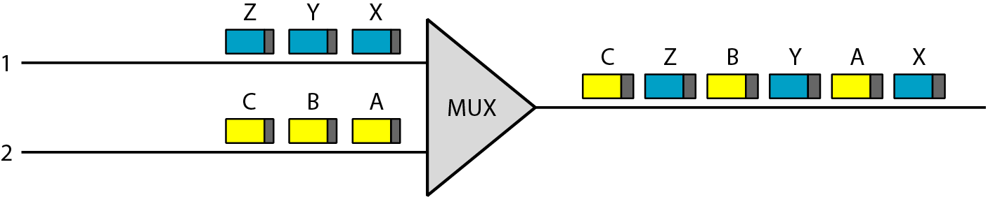
Cell Networks (Multiplexing Using Cells)
Cell Networks
  A cell is a small data unit of fixed size.
  Cell network uses the cell as the basic unit of data exchange, all data are loaded into identical cells that can be transmitted with complete predictability and uniformity.
  Because each cell is the same size and all are small, the problems associated with multiplexing different-sized frames are avoided.
  Despite interleaving, a cell network can handle real-time transmissions, such as a phone call, without the parties being aware of the segmentation or multiplexing at all.

Slide 23
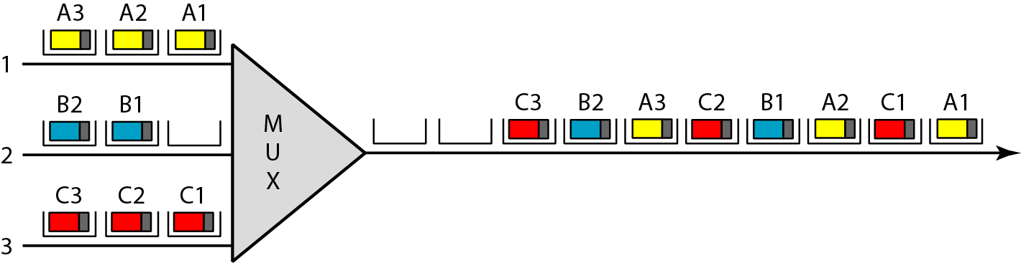
Asynchronous TDM
AsychronousTDM
  ATM uses asynchronous time-division multiplexing – that is why it is called Asynchronous Transfer Mode – to multiplex cells coming from different channels.

Slide 24
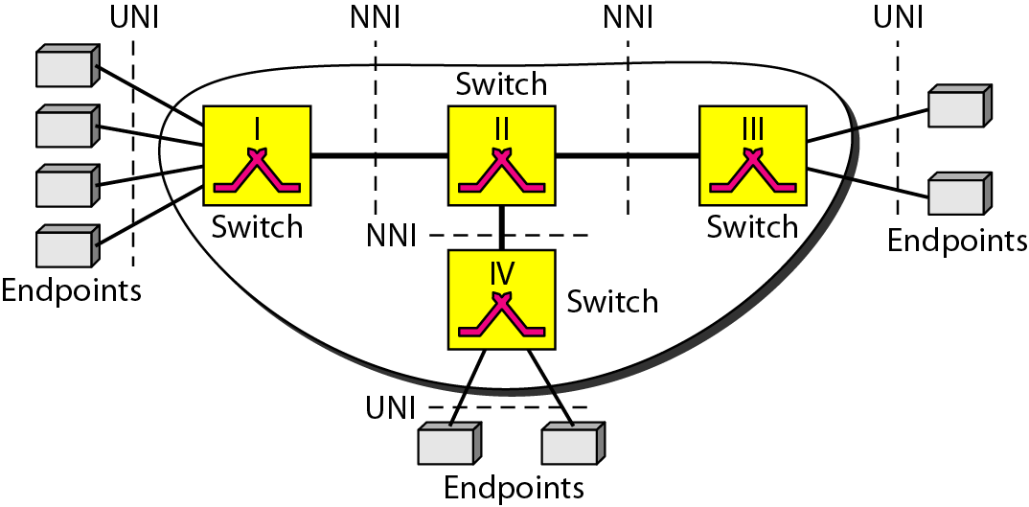
Architecture of ATM Network
Architecture
  ATM is a cell-switched network.
  The user access devices, called the endpoints, are connected through a UNI (User- to-Network Interface) to the switches inside the network.
  The switches are connected through NNI (Network-
  to-Network interface) .

Slide 25
Virtual Connection of ATM Network
Virtual Connection – Connection between two endpoints is accomplished through transmission paths (TPs), Virtual paths (VPs), and Virtual circuits (VCs).
  TP (Transmission Path)
    TP is the physical connection (cable, satellite, and so on) between an endpoint and a switch or between two switches.
  VP (Virtual Path)
    VP provides a connection or a set of connections between two switches. (A TP is divided into several VPs)
  VC (Virtual Circuit)
    A VP is logically divided into several VCs.
    Think of a VC as the lanes of highway (VP).

Slide 26
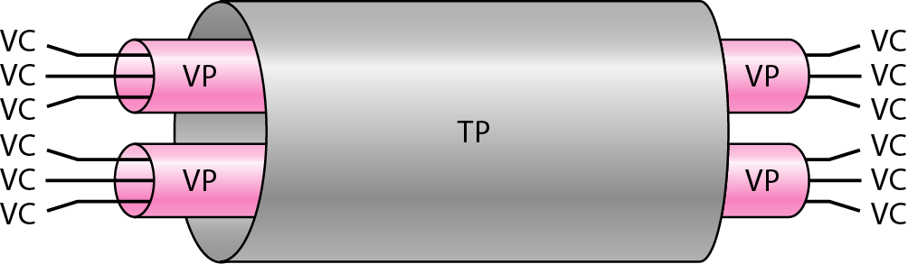
Virtual Connection of ATM

Slide 27
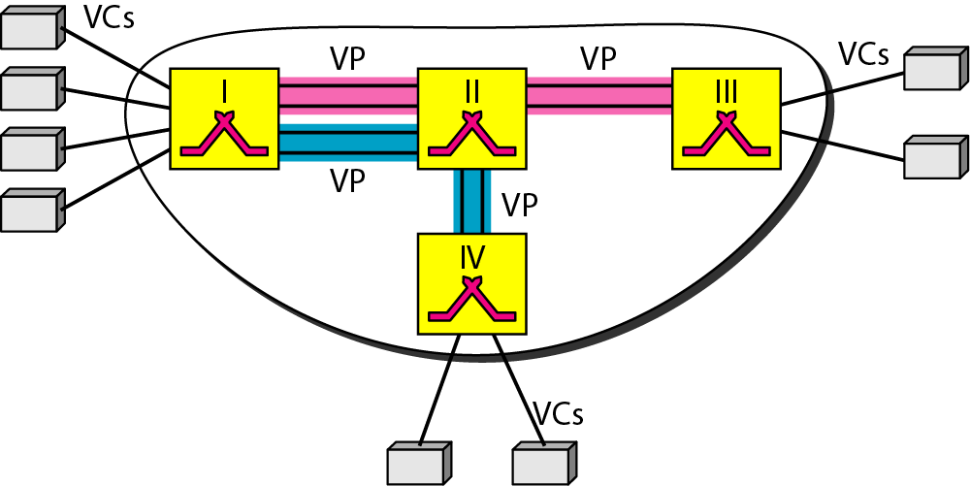
Example of VPs and VCs
Identifiers
  VPI (Virtual Path Identifier)
    The VPI defines the specific VP.
  VCI (Virtual Circuit Identifier)
    The VCI defines a particular VC inside the VP.

Slide 28
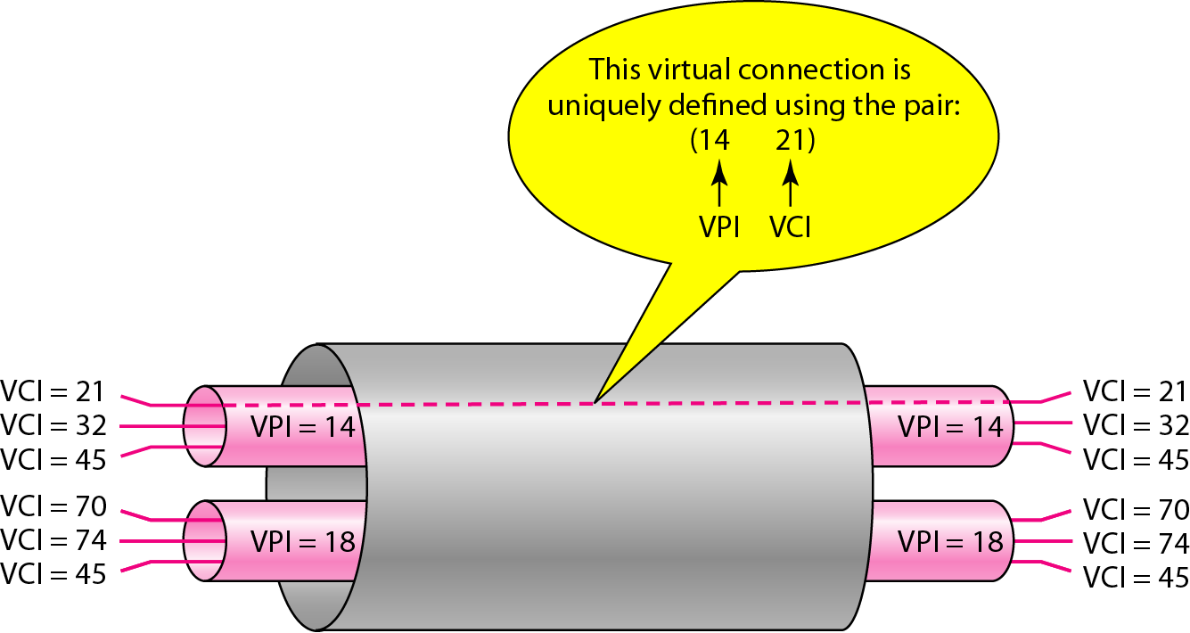
Connection Identifiers
Note that a virtual connection is defined by a pair of numbers:
the VPI and the VCI.

Slide 29
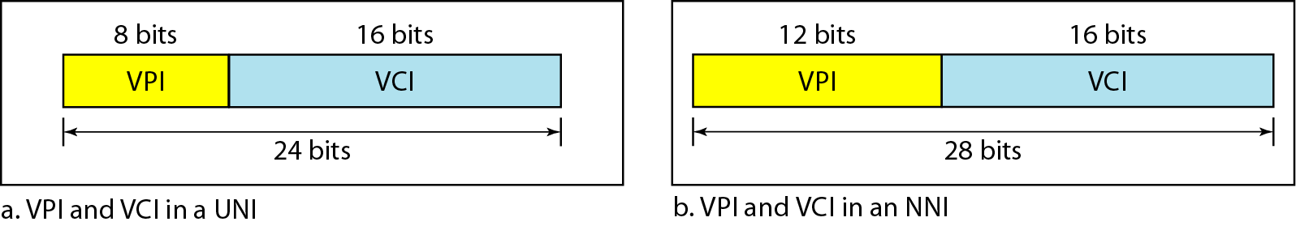
Virtual connection identifiers in UNIs and NNIs
VPI for UNI and NNI
  The lengths of the VPIs for UNIs(8b) and NNIs(12b) are different.
  The lengths of the VCI is the same in both interface (16bits)
  Dividing a VCI into two parts is to allow hierarchical routing.
Most of the switches in typical ATM network are routed using VPIs.
The switches at the boundaries of the network, those that interact directly with the endpoint devices, use both VPIs and VCIs.

Slide 30
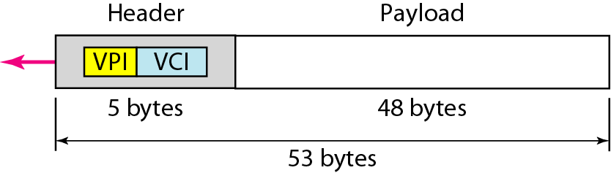
An ATM Cell
cells
  The basic data unit in an ATM network is called a cell.
  A cell is only 53 bytes long
    5 bytes allocated to the header
    48 bytes carrying the payload.

Slide 31
PVC & SVC
Connection Establishment and Release
  PVC
    The VPIs and VCIs are defined for the permanent connections, and the values are entered for the tables of each switch.
  SVC
    Each time an endpoint wants to make a connection with another endpoint, a new virtual circuit must be established.
    ATM cannot do the job by itself, but needs the network layer addresses and the services of another protocol (such as IP).

Slide 32
Summary (1)
Virtual-circuit switching is a data link layer technology in which links are shared.
A virtual circuit identifier (VCI) identifies a frame between two switches.
Frame Relay is relatively high speed, cost-effective technology that can handle bursty data.
Both PVC and SVC connections are used in Frame Relay.
The data link connections identifier (DLCI) identifies a virtual circuit in Frame Relay.
Asynchronous Transfer Mode (ATM) is a cell relay protocol that, in combination with SONET, allows high-speed connections.
A cell is a small, fixed-size block of information.
The ATM data packet is a cell composed of 53 bytes (5 bytes of header and 48 bytes of payload).

Slide 33
Summary (2)
ATM eliminates the varying delay times associated with different-size packets.
ATM can handle real-time transmission.
A user-to-network interface (UNI) is the interface between a user and an ATM switch.
A network-to-network interface (NNI) is the interface between two ATM switches.
In ATM, connection between two endpoints is accomplished through transmission paths (TPs), virtual paths (VPs), and virtual circuits (VCs).

